Slide 1
NETWORKING AND ROUTING PROTOCAL ET 8315
Tuesday, May 21, 2024
Mr. Cuthbert John Karawa
Lecture 4
ROUTING AND ROUTING PROTOCOLS
College of Information and Communication Technology (CoICT)
Department Of Electronics And Telecommunications Engineering.
1
Notes:
1

Slide 2
OUTLINE
Introduction to Static and Connected IP Routes
Learning Connected Routes
Static Routes
Dynamic Routing Overview
Terminology Related to Routing Protocols,Routing Protocol Functions
Interior and Exterior Routing Protocols
How Routing Protocols Work: Routing Protocol Algorithms
Routing Protocols Overview
A Brief Review of IP Routing
Routing Protocol Features: RIP, OSPF, EIGRP, and BGP
RIP Configuration
Summary

Slide 3
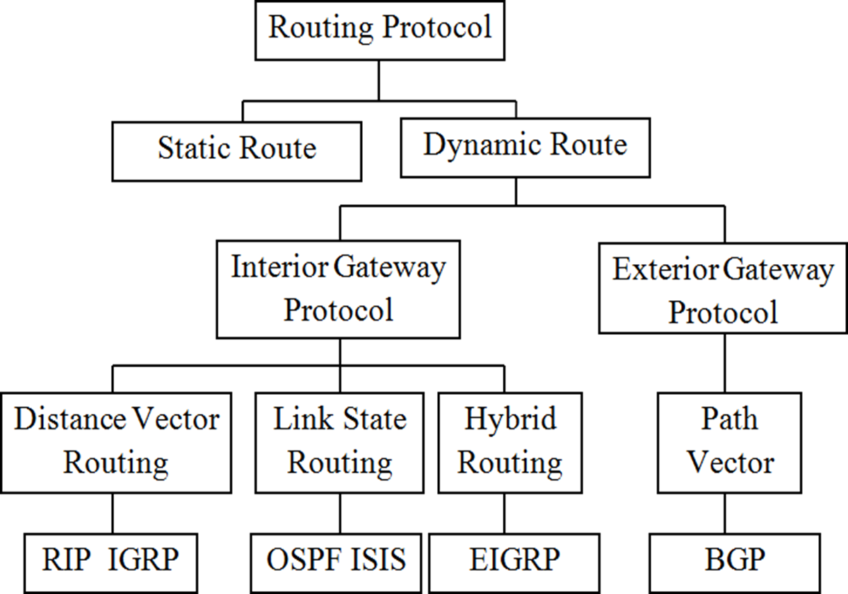
Routing Basics

Slide 4
Routing Basics
Routing is the process that a router uses to forward packets toward the destination network.
A router makes decisions based upon the destination IP address of a packet.
When routers use dynamic routing, this information is learned from other routers.
When static routing is used, a network administrator configures information about remote networks manually.

Slide 5
Role of the Router
The router is a special-purpose computer that plays a key role in the operation of any data network.
Routers are primarily responsible for interconnecting networks by
Determining the best path to send packets
Forwarding packets toward their destination
The router decides where to forward the packet base on the routing table.
To route packets, routers must have routes in their IP routing tables.

Slide 6
Routing Table
Routing table is a data structure used to store routing information acquired from different sources.
The main purpose of a routing table is to provide the router with paths to different destination networks.
Each entry in a router‘s IP routing table has important information, including the following vital information:
The destination subnet (subnet number and subnet mask).
Directions that tell the router to what other router
or host to send the packet next (outgoing interface and next-hop router).

Slide 7
Packet Routing: Basic Concepts
The three methods by which a router can add IP routes to its routing table are:
Connected routes – Adding a route to locally
connected subnets when a router's interface reaches an "up and up" state.
Static routes – Adding a route due to the engineer adding an ip route command to the router's configuration.
Dynamic routing protocols – Adding routes using routing protocols, which cause routers to dynamically exchange routing information with other routers.
7

Slide 8
Packet Routing: Basic Concepts
The three methods by which a router can add IP routes to its routing table are:
Connected routes – Adding a route to locally
connected subnets when a router‘s interface reaches an “up and up” state.
Manually, from configured static routes
Using ip route command.
Automatically, from a dynamic routing protocol
Example: RIP, OSPF, EIGRP.

Slide 9
Directly Connected Routes
Subnets to which a router‘s interfaces are connected are called connected subnets.
Routers automatically add routes to their IP routing tables for directly connected subnets, called directly connected routes.
A router adds a directly connected route for each interface that has been configured with an IP address, and is up and working.

Slide 10
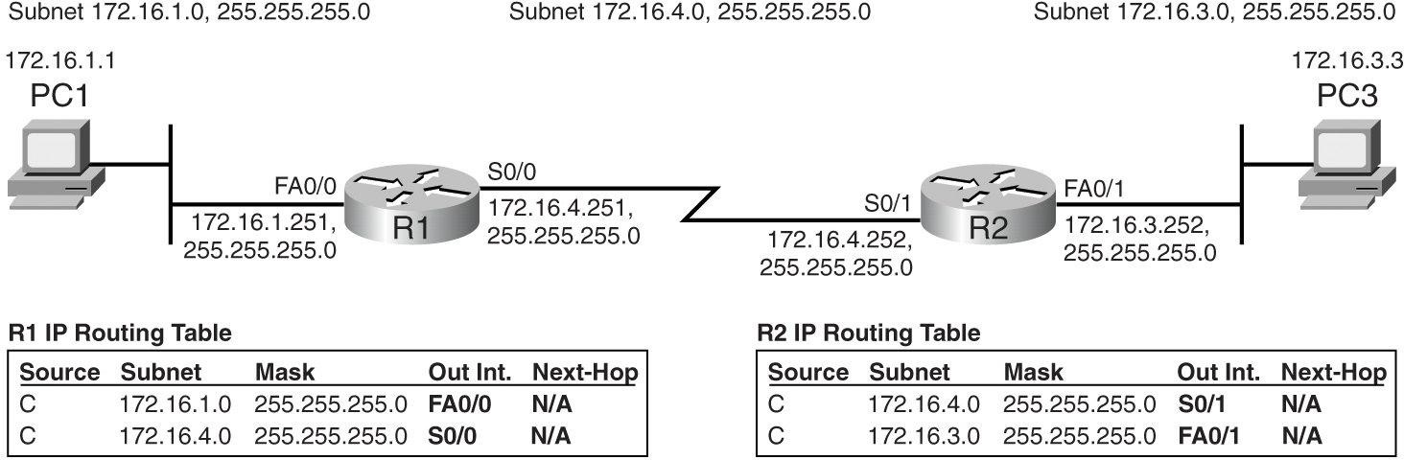
Connected Routes Only, on R1 and R2
A conceptual view of the IP routing tables in R1 and R2:
The routers were able to learn the entries in each table only because the routers are connected to these IP subnets.

Slide 11
Routing Table Fields
The following fields make up the table:
Source: This column refers to how the router learned the route - in other words, the source of the routing information. C is shorthand for "connected".
Subnet/Mask: These two fields together define a set of IP addresses, either an IP network or IP subnet. When routing packets, routers compare the destination IP address of packets to this field in each route in the routing table, looking to find the matching route.

Slide 12
Routing Table Fields
Out Int: The abbreviation for “output interface” or “outgoing interface,” this field tells the router out of which interface to send packets that match this route.
Next-Hop: Short for next-hop router, this field is meaningless for routes to connected subnets. For routes in which the packet is forwarded to another router, this field lists the IP address of the router to which this router should forward the packet.

Slide 13
Static Routes
A static route is simply a route that is added using a configuration command in a router.
After it is configured, IOS adds the route, including details such as the subnet number, mask, output interface, and next-hop router, into a new entry in that router‘s IP routing table.
After it is added, the router can then route packets whose destination IP address matches the static route.
Engineers use static routes for several reasons. They could configure static routes for all routes in any internetwork, but typically it is not worth the effort.

Slide 14
Static Routes
However, static routes can be very useful in several cases, including the following:
The internetwork is small, may seldom change, or has no redundant links.
The routers need to use dial backup to dynamically call another router when a leased line fails.
An enterprise internetwork has many small branch offices, each with only one possible path to reach the rest of the internetwork.
An enterprise wants to forward packets to hosts in the Internet, not to hosts in the enterprise network.

Slide 15
Static Routes in a Small, Non-redundant Network
In a small internetwork that has no redundancy and seldom changes, you may simply choose to configure static routes and not bother with an IP routing protocol.
In a real world, the most engineers would still choose to use a dynamic routing protocol even in a small internetwork, but such an internetwork provides a good example for showing the mechanics of configuring static routes with the ip route global configuration command.

Slide 16
Static routing versus dynamic routing
Static routing
Fixes routes at boot time
Useful only for simplest cases
Dynamic routing
Table initialized at boot time
Values inserted/updated by protocols that propagate route information
Necessary in large Networks

Slide 17
Configuring static routes
Static routes are entered manually by the network admin.
Anytime the network topology changes, admin must update the routes
Specifying the Next-hop IP Address
Router(config)# ip route network-address subnet-mask {ip-address | exit-interface}

Slide 18
Configuring static routes
Router(config)# ip route network-address subnet-mask {ip- address | exit-interface}
The following parameters are used:
network-address: Destination network address of the remote network to be added to the routing table.
subnet-mask: Subnet mask of the remote network to be added to the routing table. The subnet mask can be modified to summarize a group of networks.

Slide 19
Configuring static routes
One or both of the following parameters must also be used:
ip-address: Commonly referred to as the next-hop router‘s IP address.
exit-interface: Outgoing interface that would be used in forwarding packets to the destination network.

Slide 20
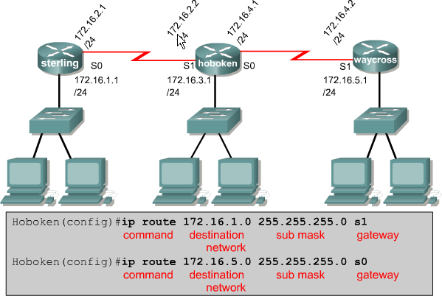
Configuring a Static Route with an Exit Interface

Slide 21
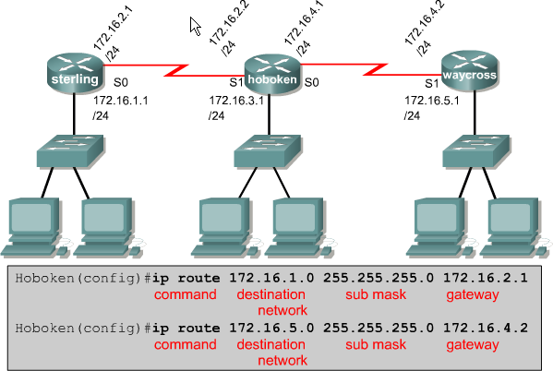
Configuring static routes

Slide 22
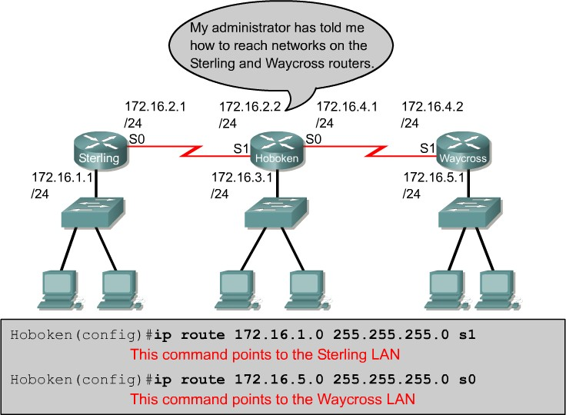
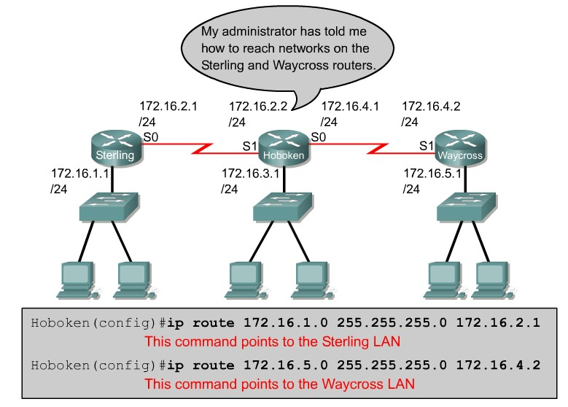
Configuring static routes
Two choices.

Slide 23
Static Routing
In privileged mode enter the command show running- config to view the active configuration.
Verify that the static route has been correctly entered. If the route is not correct, it will be necessary to go back into global configuration mode to remove the incorrect static route and enter the correct one.
Enter the command show ip route command to verify that the route that was configured is in the routing table.

Slide 24
Configuring static routes
192.168.2.0/24
172.16.0.0/16 192.168.1.0/24
10.1.0.0/16
RTA RTB RTC
s0 s0 s1 s1
e0
e0
.1 .1 .2 .1 .2
RTA(config)#ip route 192.168.1.0 255.255.255.0 172.16.0.2
RTA(config)#ip route 10.1.0.0 255.255.0.0 172.16.0.2
.1
RTB(config)#ip route 192.168.2.0 255.255.255.0 172.16.0.1
RTB(config)#ip route 10.1.0.0 255.255.0.0 192.168.1.2
RTC(config)#ip route 192.168.2.0 255.255.255.0 192.168.1.1
RTC(config)#ip route 172.16.0.0 255.255.0.0 192.168.1.1

Slide 25
Configuring static routes
192.168.2.0/24
172.16.0.0/16 192.168.1.0/24
10.1.0.0/16
RTA RTB RTC
s0 s0 s1 s1
e0
e0
.1 .1 .2 .1 .2
.1
RTA#show ip route
Codes: C - connected, S - static,
C 172.16.0.0/16 is directly connected, Serial0 10.0.0.0/16 is subnetted, 1 subnets
S 10.1.0.0 [1/0] via 172.16.0.2
S 192.168.1.0/24 [1/0] via 172.16.0.2
C 192.168.2.0/24 is directly connected, Ethernet0 RTA#

Slide 26
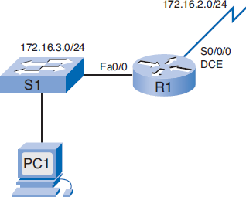
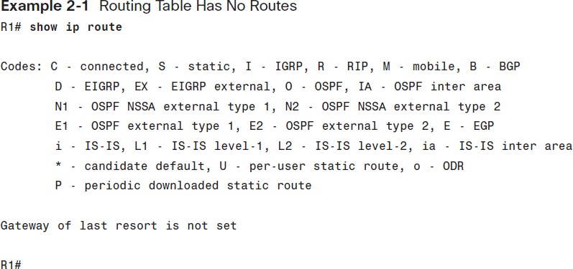
Show ip route command
The show ip route command is used to display the routing table. Initially, the routing table is empty if no interfaces have been configured.

Slide 27
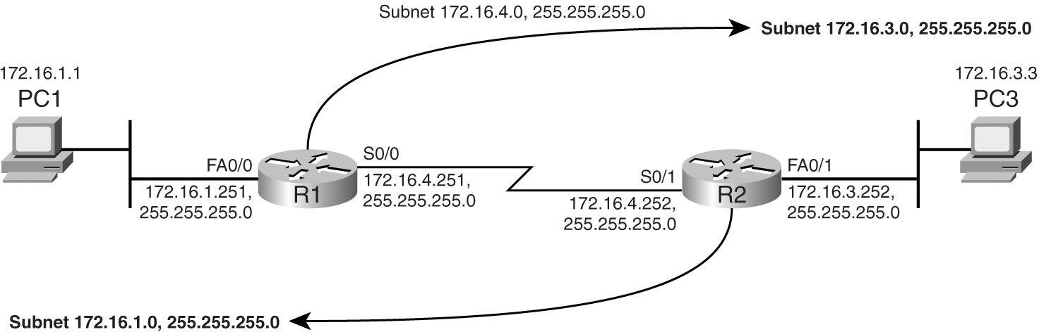
Static Route Configurations
The internetwork has three subnets: 172.16.1.0, 172.16.4.0, and 172.16.3.0, all with masks of 255.255.255.0.
Both routers know how to reach two of the directly connected subnets.
Each router needs one more route to reach the remaining subnet.

Slide 28
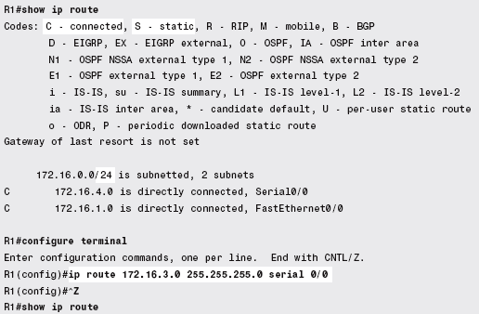
R1: Configuring a Static Route Using the Outgoing Interface
When point-to-point topologies such as leased lines are used,
ip route command can simply refer to the outgoing interface

Slide 29
R1: Configuring a Static Route Using the Outgoing Interface
When point-to-point topologies such as leased lines are used, ip route command can simply refer to the outgoing interface.
The show ip route command now lists the new static route.

Slide 30

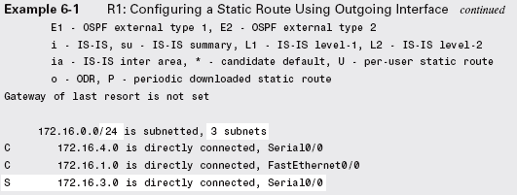
R1: Configuring a Static Route Using the Outgoing Interface

Slide 31
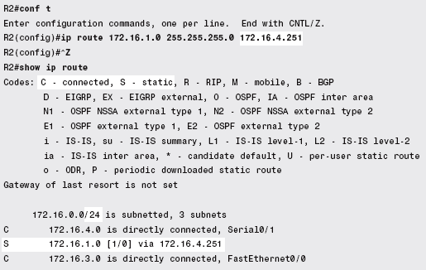
R2: Configuring a Static Route Using the Next-Hop IP Address

Slide 32
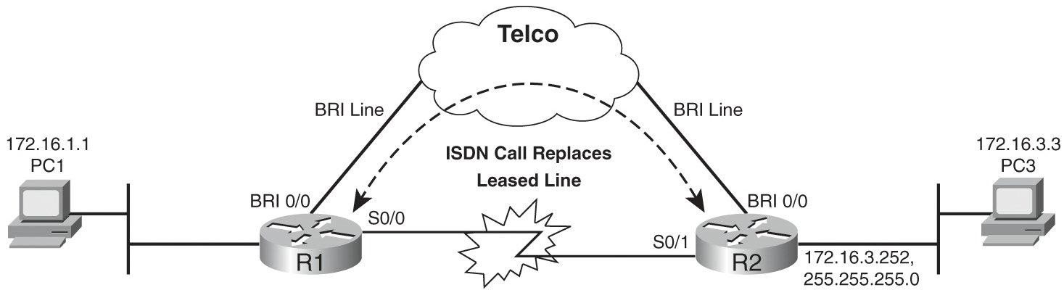
ISDN Dial Backup
Dial backup provides a way for a router to use some permanent WAN services, such as a leased line, but when that leased line fails, the router can use the telephone network and replace the failed WAN link.

Slide 33
ISDN Dial Backup
Most often today, the link would use Integrated Services Digital Network (ISDN) services, often an ISDN Basic Rate Interface (BRI) line.

Slide 34
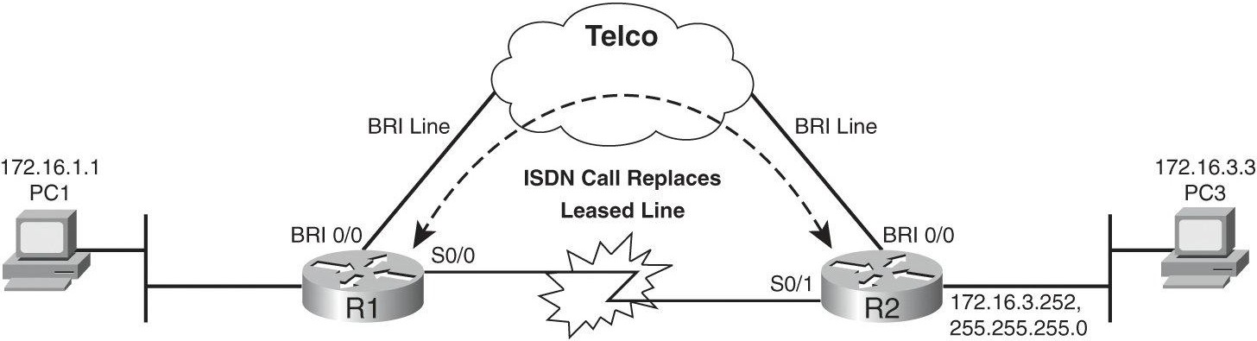
ISDN Dial Backup
Each router has an ISDN BRI interface, connected to an ISDN line.
ISDN line is similar to a local telephone line, except that it supports digital data at speeds up to 128 kbps.

Slide 35
ISDN Dial Backup
Routers backup the leased line with the BRI line: One router calls the other router automatically Dial on Demand Routing(DDR), and the two routers can forward packets to each other.
Notes:
Dial on Demand Routing(DDR) is a routing technique where a network connection to a remote site is established only when needed.

Slide 36
The Need for Static Routes
The dial backup configuration uses static routes. The need for static routes is shown by these facts:
When the leased line is up, the routers learn routes using a dynamic routing protocol.
When the leased line fails, the routers lose the routes learned by the dynamic routing protocol.
Before dial backup dials an ISDN call, at least one router must try to route a packet out its BRI interface.
A router needs a static route to be configured, referencing the BRI interface as the outgoing interface to force the try to route a packet out its BRI interface.

Slide 37
Administrative Distance on Static Routes
Some styles of dial backup configuration require a static route, and these static routes tell a router to try to route the packets out a BRI interface. R1‘s configuration might include a command like this:
ip route 172.16.3.0 255.255.255.0 bri0/0
This command solves one problem for dial backup configuration: the packets destined for the LAN subnet 172.16.3.0/24 are routed out R1‘s BRI0/0 interface.
However, this command creates yet another problem: which route does R1 use when the leased line is up?

Slide 38
Administrative Distance on Static Routes
R1 will have a static route that references interface BRI0/0, and a Routing Information Protocol(RIP)- learned route that references R1‘s S0/0 interface, so which is better?
By design, the engineer wants to route packets over the leased line when it is working and use the (probably slower) ISDN lines only when the leased line fails.

Slide 39
Administrative Distance on Static Routes
An administrative distance is the metric used by routers to choose the best path when there are two or more routes to the same destination from two different routing protocols.
Administrative Distance – This is the “trustworthiness" of the routing information.
Lower the AD the more trustworthy.
default administrative distance of static routes is 1.
The Administrative Distance of a directly connected route is 0.
If the router learns about a route to a network from more than one source, it will install the route with the lower administrative distance in the routing table.

Slide 40
Administrative Distance on Static Routes
An administrative distance guides the selection of one routing protocol (or static route) over another, when more than one protocol adds the same route to the unicast routing table.
Each routing protocol is prioritized in order of most to least reliable using an administrative distance value.

Slide 41
Administrative Distance on Static Routes
When the leased line is working, R1 learns a Routing Information Protocol (RIP) route for 172.16.3.0/24, and it has the static route that references interface BRI0/0.
In such cases, the router uses the route with the lowest administrative distance.
RIP-learned routes have an administrative distance of 120 by default, and static routes have an administrative distance of either 0 or 1 by default.
Routing Information Protocol (RIP) is a dynamic routing protocol that uses hop count as a routing metric to find the best path between the source and the destination network.

Slide 42
Administrative Distance on Static Routes
If the ip route 172.16.3.0 255.255.255.0 bri0/0 command is configured, it has a lower administrative distance than the RIP-learned route, and R1 uses the static route.
A router prefers a static route to a dynamic route because the router considers a route with a low number to be the shortest.

Slide 43
Administrative Distance on Static Routes
If you want a dynamic route to override a static route, you can specify an administrative distance for the static route.
For example, if you have two dynamic routes with an administrative distance of 120 (RIP), you would specify an administrative distance that is greater than 120 for the static route if you want the dynamic route to override the static route.

Slide 44
Administrative Distance on Static Routes
The administrative distance can be used to compare routes learned by multiple different routing protocols as well.
If, for example, a router uses both RIP and OSPF (which makes sense in some cases), the router might learn (with RIP) a hop-count-3 route to a destination subnet, and (with OSPF) a cost-54 route to the same subnet.

Slide 45
Administrative Distance on Static Routes
It is impossible to compare the totally different metrics and tell which route is best, so the router uses the administrative distance, choosing the OSPF route because, by default, OSPF has a lower administrative distance (110) than RIP (120).
The administrative distance can be used to compare routes learned by multiple different routing protocols as well.

Slide 46
Administrative Distance on Static Routes
If, for example, a router uses both RIP and OSPF (which makes sense in some cases), the router might learn (with RIP) a hop-count-3 route to a destination subnet, and (with OSPF) a cost-54 route to the same subnet.
It is impossible to compare the totally different metrics and tell which route is best, so the router uses the administrative distance, choosing the OSPF route because, by default, OSPF has a lower administrative distance (110) than RIP (120).

Slide 47
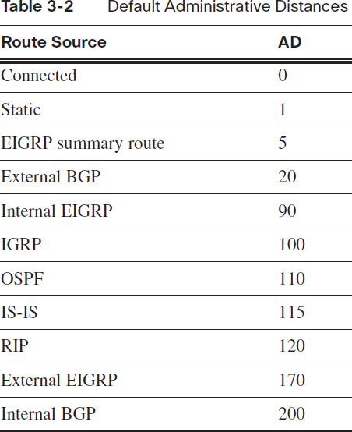

Slide 48
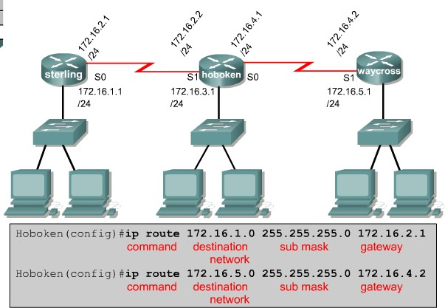
Administrative Distance and Metric
[ administrative distance / routing metric (or cost) ]
The cost for all static routes is '0'
The default administrative distance for static routes is ‘1’
Hoboken#show ip route
Codes: C - connected, S - static,
S 172.16.1.0/24 C
[1/0]
is directly connected, Serial0
192.168.2.0/24 is directly connected, Ethernet0
[1/0] – [ Administrative Distance / Metric ]

Slide 49
Statically Defined Default Routes
A default route is used to represent all routes with zero or no bits matching. In other words,when there are no routes that have a more specific match, the default route will be a match.
When a router receives a packet whose destination address is not found in the router‘s IP routing table, the router discards the packet, unless a default route has been configured.
Default route tells a router where to send packets that do not match any of that router's other IP routes.

Slide 50
Statically Defined Default Routes
With a default route, the router forwards the packet based on the instructions in the default route.
Default routes can be most useful in two major cases:
In enterprise routers that have only one possible physical path to forward packets to the rest of the internetwork
To route packets from a company to the Internet, when the company has a single connection to the Internet.

Slide 51
Configuring a Default Static Route
The syntax for a default static route is similar to any other static route, except that the network address is 0.0.0.0 and the subnet mask is 0.0.0.0
Router(config)# ip route 0.0.0.0 0.0.0.0 [exit- interface | ip-address ]
Example: R1(config)# ip route 0.0.0.0 0.0.0.0 serial 0/0/0.

Slide 52
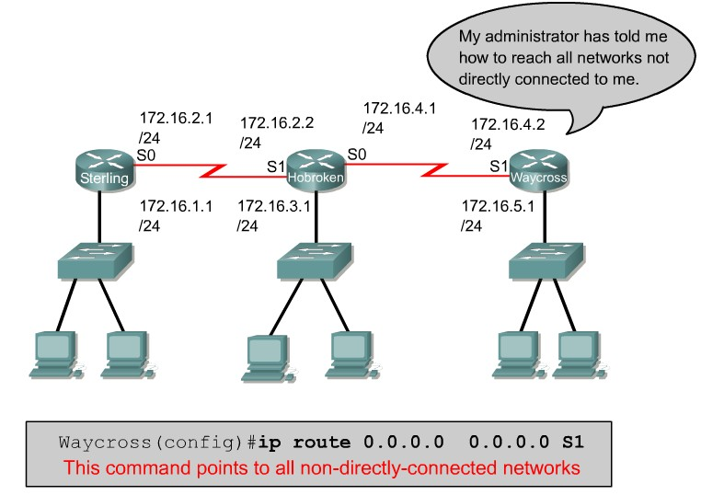
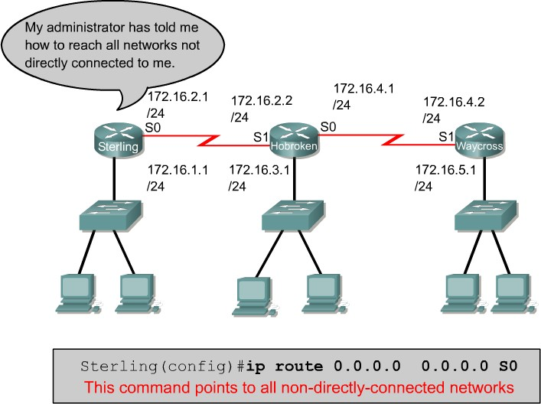
Configuring a Default Static Route
The network 0.0.0.0 and mask 0.0.0.0 are known as a “default route”

Slide 53
Verifying Static Routes
Verifying whether static routes work correctly requires a few steps. The following list points out the highlights:
Because the routes are added in configuration mode, once the network engineer is convinced that the routes are configured correctly, the saves the configuration (copy running-config startup-config) to ensure that the routes are saved and are reloaded after the next reload of the router.

Slide 54
Verifying Static Routes
When configured, the routes should be seen in the output of the show ip route command, with an S in the left colomn, unless one of the following is also true:
If the outgoing interface is down, the route is not in the routing table.
If the network engineer sets the administrative distance on the ip route command, and the static route has a higher administrative distance than the administrative distance of another route to the same subnet, the static route is not listed in the routing table.

Slide 55
Verifying Static Routes
As with testing any routes, regardless of how they were learned, the ping and traceroute commands can help verify if all required routes between a source and destination are working.

Slide 56
Testing Routes with ping and traceroute commands
The traceroute command works very well for testing routes.
The ping command tells you whether the complete end-to-end route works, but the traceroute command tells you the first router that has a problem.
Example on the next slide shows sample traceroute command output, with the traceroute command never completing, which requires the user to stop the command by using a break sequence.

Slide 57
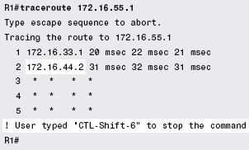
Testing Routes with ping and traceroute
commands
The command output confirms that the traceroute command‘s packets successfully got to a router whose IP address is 172.16.33.1, and to a router whose address is172.16.44.2, but no further.
Now, the engineer can telnet to the last router in the traceroute command‘s output (172.16.44.2) and continue troubleshooting, getting closer to the cause of the problem.

Slide 58
Dynamic Routing Protocols
Advantages of static routing
It can backup multiple interfaces/networks on a router
Easy to configure
No extra resources are needed
More secure
Disadvantages of static routing
Network changes require manual reconfiguration
Does not scale well in large topologies

Slide 59
Routers Route Packets
Routers are network devices that deliver packets (more precisely – frames) from the source to destination.
Routers have two major mechanisms that allow them not only to deliver packets with a required reliability and quality, but also to find the best available path for delivery along entire network. These mechanism are routed (or routable) and routing protocols.
Routed (routable) and routing protocols are totally different groups of protocols, but they do work very closely for the common goal – efficient transfer of information.

Slide 60
Routed and Routing Protocols
Routing protocol
A set of messages, rules, and algorithms used by routers for the overall purpose of learning routes.
This process includes the exchange and analysis of routing information.
Each router chooses the best route to each subnet (path selection) and
Places those best routes into its IP routing table. Examples include RIP, EIGRP, OSPF, and BGP.

Slide 61
Routing Protocol Functions
All IP routing protocols perform the same general functions:
Learn routing information about IP subnets from other neighboring routers.
Advertise routing information about IP subnets to other neighboring routers.
If more than one possible route exists to reach one subnet, pick the best route based on a metric.
If the network topology changes—for example, a link fails— react by advertising that some routes have failed, and pick a new currently best route. (This process is called convergence.)

Slide 62
Routed and Routing Protocols
Routed protocol (routable protocol)
Refer to a protocol that defines
A packet structure and
Logical addressing,
Allowing routers to forward or route the packets defined by that protocol.
Routers forward, or route, packets defined by routed and routable protocols.
Examples include IP and IPX (a part of the Novell NetWare protocol model).

Slide 63
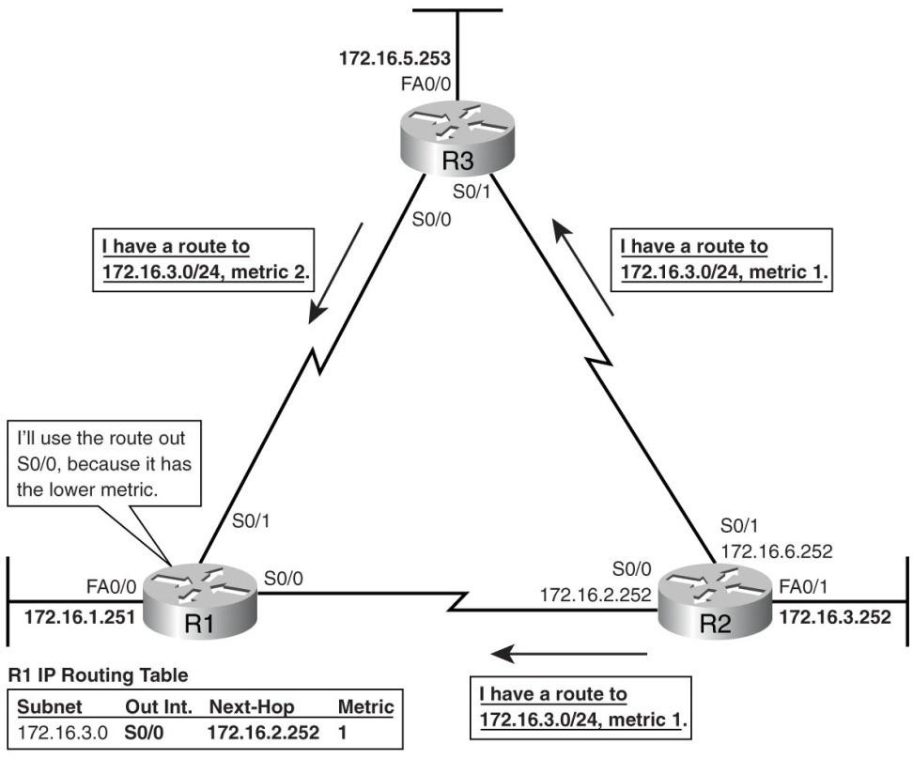
Basic Functions of Routing Protocols
Routing Information Protocol (RIP) as the routing protocol
R2 advertises a route for subnet 172.16.3.0/24 to both R1 and R3
R3 learns the route to 172.16.3.0/24 and then advertises that route to R1, which is the second function in the preceding list.
R1 hears of two routes to reach 172.16.3.0/24: one with metric 1 from R2, and one with metric 2 from R3.
R1 chooses the lower- metric route through R2.

Slide 64
Network Convergence
When something in the network changes, the best routes available may change.
The term convergence refers to a process that occurs when the topology changes
A router or link fails or
Comes up
Convergence is the process by which all the routers collectively realize something has changed, advertise the information about the change to all the other routers, and then choose the currently best routes for each subnet.

Slide 65
Network Convergence
The ability to converge quickly, without causing loops, is one of the most important features of every routing protocol.
When all routers in an internetwork operate with the same knowledge, the internetwork is said to have converged.
The routing protocols must recognize changes in the network topology and ensure that all routers know about the changes for the internetwork to converge.

Slide 66
Autonomous System (AS)
Autonomous system (AS) is an internetwork under the administrative control of a single organization:
An internetwork administered by a single organization is probably a single AS
All of the routers in an autonomous systems communicate using and "interior gateway protocol"
Autonomous systems (AS) are identified by an Autonomous systems number ASN

Slide 67
Autonomous System Number
Each AS can be assigned a number, called an autonomous system number (ASN).
Like public IP addresses, the Internet Assigned Numbers Authority (IANA,http://www.iana.org) controls the worldwide rights to assign ASNs, delegating that authority to other organizations around the planet, typically to the same organizations that assign public IP addresses.

Slide 68
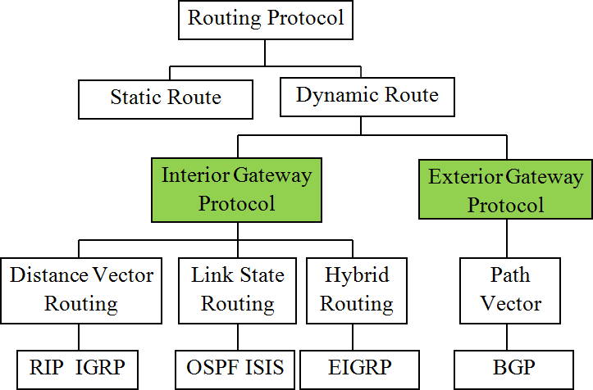
Interior and Exterior Routing Protocols

Slide 69
Interior and Exterior Routing Protocols
IP routing protocols fall into one of two major categories:
Interior Gateway Protocols (IGPs) and
Exterior Gateway Protocols (EGPs).
The definitions for each are as follows:
IGP: A routing protocol that was designed and intended for use inside a single autonomous system (AS).
EGP: A routing protocol that was designed and intended for use between different autonomous system.

Slide 70
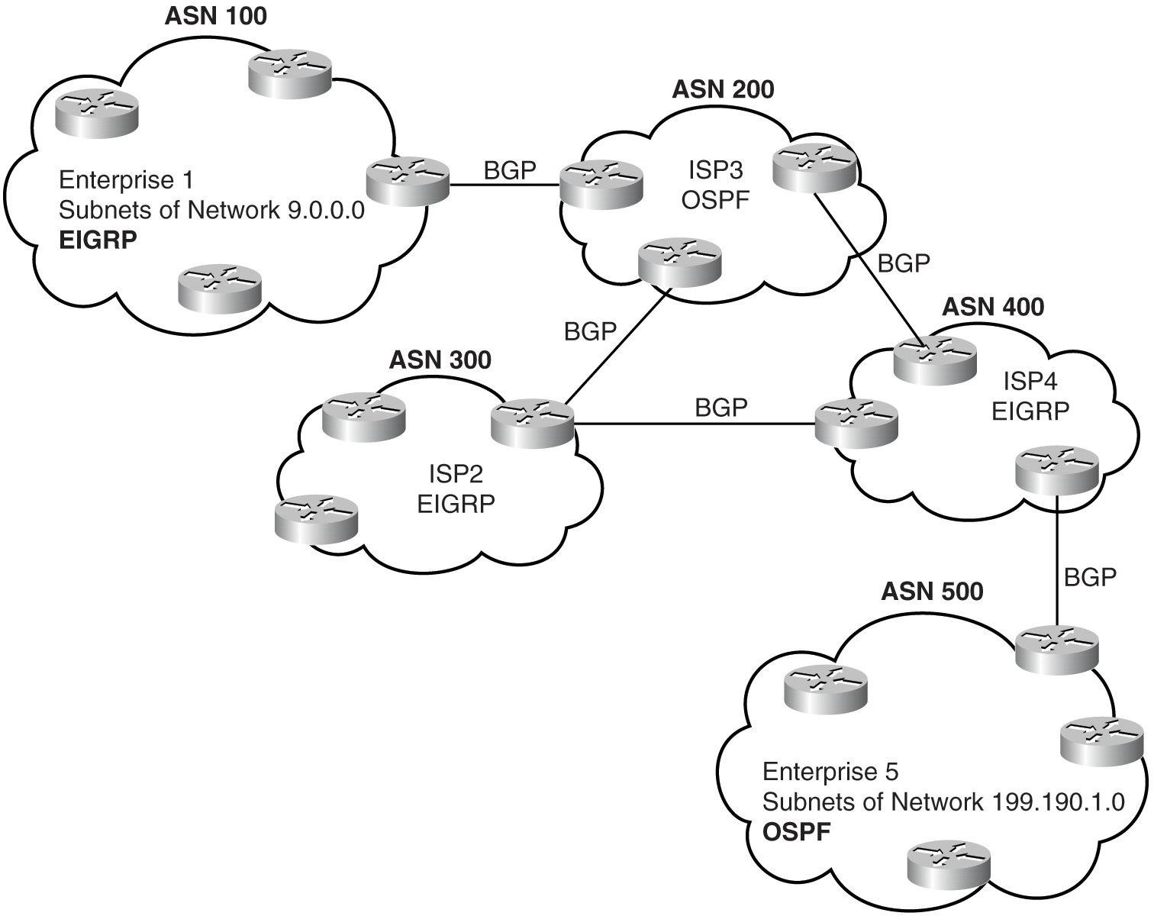
Locations for Using IGPs and EGPs
Two companies and three ISPs use IGPs (OSPF and EIGRP) inside their own networks, with BGP being used between the ASNs.

Slide 71
Routing Protocol Algorithms
The term routing protocol algorithm refers to the algorithm used by different routing protocols to solve the problem of learning all routes, choosing the best route to each subnet, and converging in reaction to changes in the internetwork.
Three main branches of routing protocol algorithms exists for IGP routing protocols:
Distance vector (sometimes called Bellman-Ford after its creators)
Link state
Balanced hybrid (sometimes called enhanced distance vector).

Slide 72
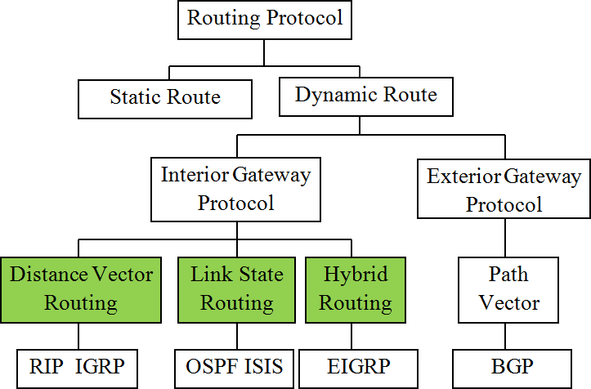
Routing Protocol Algorithms

Slide 73
Metric to Determine Route
Metric is a numerical value used by the routing protocols to determine which is the best path to a destination
The smaller the metric value the better the path
Typically four factors are used
Delay
Bandwidth
Reliability
Loading
The more the factors the algorithm used, the higher the complexity, and thus higher resources are required
Bandwidth
CPU
Time (convergence)
Memory

Slide 74
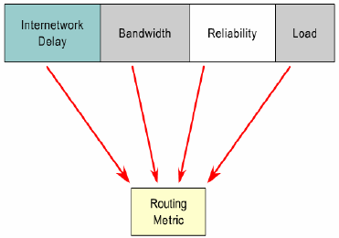
Metric to Determine Route

Slide 75
Metric to Determine Route
Equal cost metric is a condition where a router has multiple paths to the same destination that all have the same metric
To solve this dilemma, a router will use Equal Cost Load Balancing - this means the router sends packets over the multiple exit interfaces listed in the routing table.

Slide 76
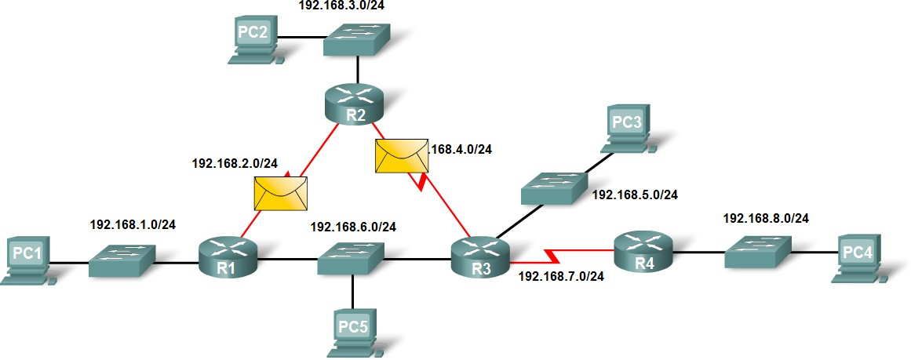
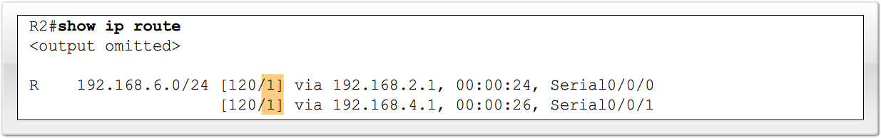
Metric to Determine Route

Slide 77
Distance Vector Routing Protocols
The distance vector routing approach determines the direction (vector) and distance to any link in the internetwork.
Distance vector routing algorithms pass periodic copies of a routing table from router to router
Each router receives a routing table from its directly connected neighbor routers
The algorithm eventually accumulates network distances so that it can maintain a database of network topology information.

Slide 78
Distance Vector Routing Protocols
However, distance vector algorithms do not allow a router to know the exact topology of an internetwork as each router only sees its neighbor routers.
Each router that uses distance vector routing begins by identifying its own neighbor.
As the distance vector network discovery process proceeds, routers discover the best path to destination networks based on the information they receive from each neighbor.

Slide 79
Distance Vector Routing Protocols
Distance vector routing protocols advertise a small amount of simple information about each subnet to their neighbors.
Their neighbors in turn advertise the information to their neighbors, and so on, until all routers have learned the information.

Slide 80
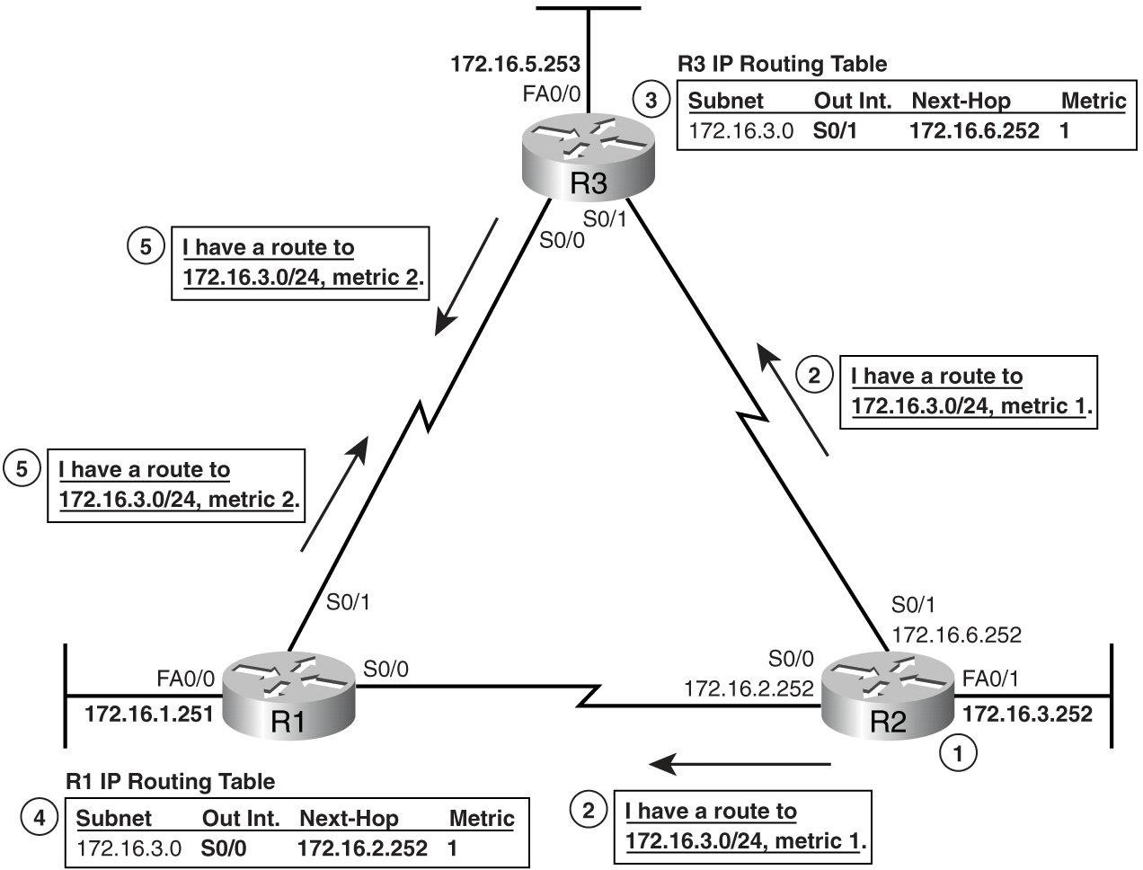
How RIP Advertises Routes
Router R2 learns a connected route for subnet 172.16.3.0.
R2 sends a routing update to its neighbors, listing a subnet (172.16.3.0) and a distance, or metric (1 in this case).
R3 hears the routing update and adds a route to its routing table for subnet 172.16.3.0, referring to R2 as the next-hop router.
Around the same time, R1 also hears the routing update sent directly to R1 from R2. R1 then adds a route to its routing table for subnet 172.16.3.0, referring to R2 as the next-hop router.
R1 and R3 send a routing update to each other, for subnet 172.16.3.0, metric 2.
RIP sends periodic routing updates every 30 seconds by default.
metric determines how good each route is.

Slide 81
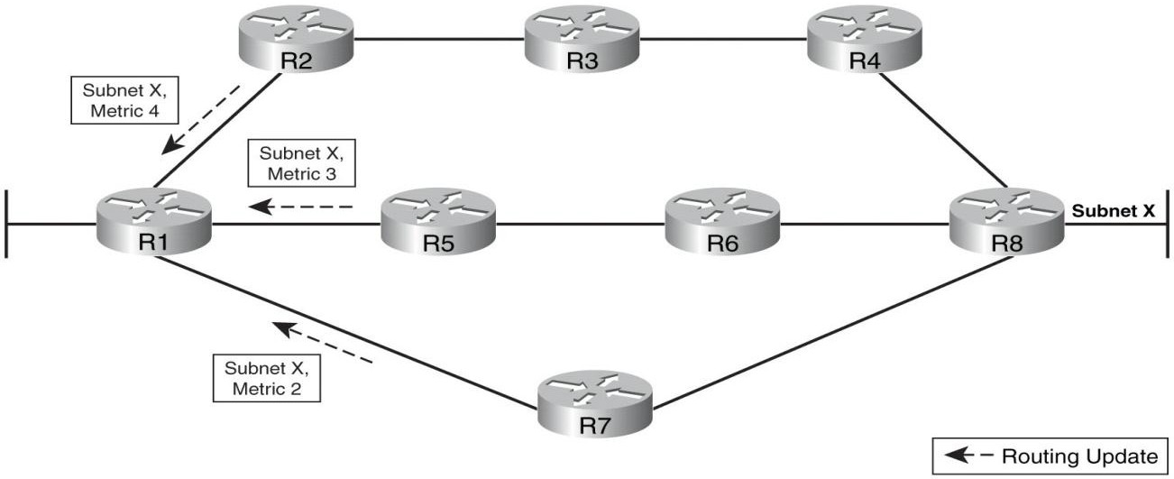
Using a Hop Count Metric to Choose a Route
R1 has three routes to subnet X to consider:
The four-hop route through R2
The three-hop route through R5
The two-hop route through R7
R1 picks the best route to reach subnet X, and in this case, it picks the two-hop route through R7 because that route has the lowest metric.

Slide 82
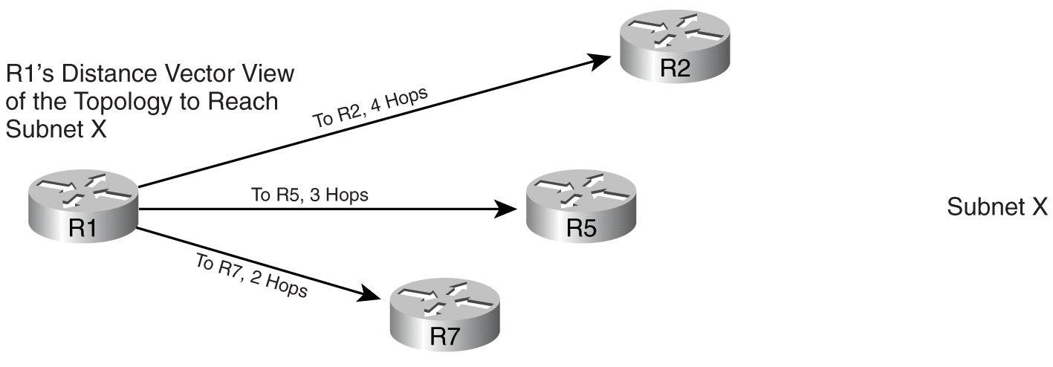
A Graphical Representation of the Distance Vector Concept
All the routing protocols know is some concept of a vector: a vector‘s length is the distance (metric) to reach a subnet, and a vector‘s direction is through the neighbor that advertised the route.

Slide 83
A Graphical Representation of the Distance Vector Concept
All R1 knows about subnet X is three vectors. The length of the vectors represents how far away the subnet is over a particular route, and the direction of the vector represents the next-hop router.

Slide 84
Distance Vector Protocols Summary
To summarize, distance vector protocols use the following concepts:
They send full periodic routing updates.
The updates include a list of subnets and their respective distances (metrics), but nothing else.
Routers do not know the details about the network‘s topology beyond a neighboring router.
Like all routing protocols, if multiple routes to the same subnet exist, the router chooses the route with the lowest metric.

Slide 85
Link-State Routing Protocols
Link-state algorithms are also known as Dijkstras algorithm or as SPF (shortest path first) algorithms.
Link-state protocols were first introduce to IP internetworking in the early 1990s, roughly ten years after the original distance vector protocols.
The designers of the link-state routing protocols created algorithms that solved many of the problems with the earlier distance vector protocols
Slow convergence
High bandwidth utilization

Slide 86
Link-State Routing Protocols
A link-state routing algorithm maintains full knowledge of distant routers and how they interconnect.

Slide 87
Flooding and Link-State Database
Routers using link-state routing protocols need to collectively advertise practically every detail about the internetwork to all the other routers.
At the end of the process, called flooding, every router in the internetwork has the exact same information about the internetwork as all the other routers.
This information, stored in RAM in a data structure called the link-state database (LSDB), is then used in the other major step to find the currently best routes to each subnet.

Slide 88
Flooding and Link-State Database
Flooding a lot of detailed information to every router sounds like a lot of work, and relative to distance vector routing protocols, it is.

Slide 89
Open Shortest Path First (OSPF) Protocol
Open Shortest Path First (OSPF), the most popular link-state routing protocol, advertises information in routing update messages, with the updates containing information called link-state advertisements (LSAs).
LSAs come in many forms, including the following two main types:
Router LSA: Includes a number to identify the router (router ID), the router‘s interface IP addresses, the state (up or down) of each interface, and the cost (metric) associated with the interface.
Network LSA: Identifies each link (subnet) and the routers that are attached to that link. It also identifies the state (up or down) of the link.

Slide 90
Discover the topology of the network
Link-state advertisements (LSAs) – A link-state advertisement (LSA) is a small packet of routing information that is sent between routers.
Topological database – A topological database is a collection of information gathered from LSAs.
SPF algorithm – The shortest path first (SPF) algorithm is a calculation performed on the database resulting in the SPF tree.
Routing tables – A list of the known paths and interfaces.

Slide 91
Link-State Routing Protocols
Using link-state protocols, each router creates a router LSA for itself and floods that LSA to other routers in routing update messages. To flood an LSA, a router sends the LSA to its neighbors; those neighbors in turn forward the LSA to their neighbors, and so on, until all the routers have learned about the LSA.
Each router in parallel with the others constructs a topological database consisting of all the exchanged LSAs.

Slide 92
Link-State Routing Protocols
The SPF algorithm computes network reachability. The router constructs this logical topology as a tree, with itself as the root, consisting of all possible paths to each network in the link-state protocol internetwork
When the router receives an LSA, the database is updated with the most recent information and computes a map of the internetwork using the accumulated data and calculates the shortest path to other networks using the SPF algorithm.

Slide 93
Link-State Routing Protocols
At the end of the process, every router has every other router‘s router LSA and a copy of all the link LSAs as well.

Slide 94
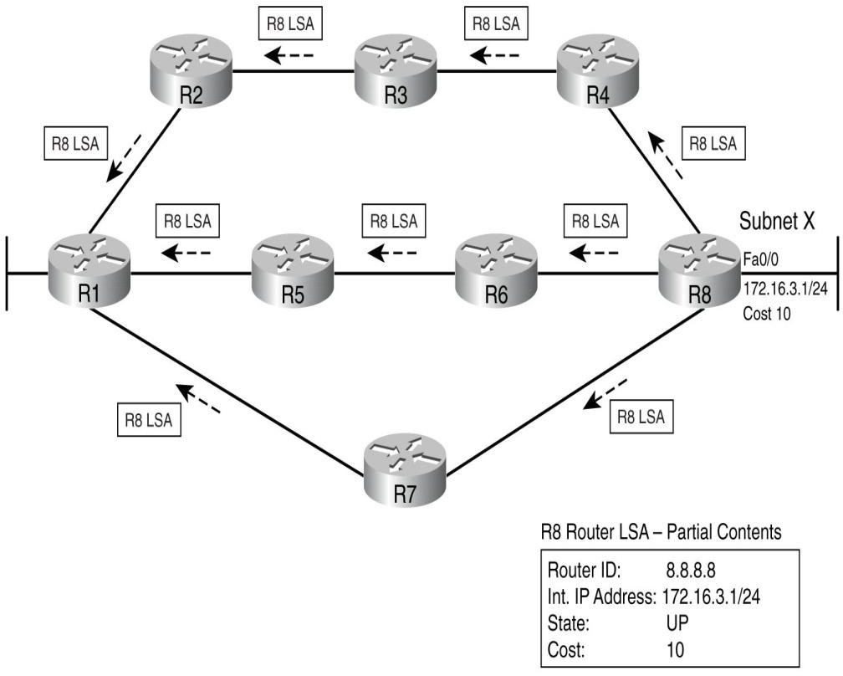
Flooding LSAs Using a Link-State Routing Protocol
R8 creating and flooding its router LSA.
Figure actually shows only a subset of the information in R8’s router LSA.
Every router would create and flood a router LSA for itself, using the same general process used by R8.
Some routers would also create and flood link LSAs, which describe a link or subnet to which multiple routers connect.

Slide 95
Flooding LSAs Using a Link-State Routing Protocol (Continued)
After the LSA has been flooded, even if the LSAs do not change, link-state protocols require periodic reflooding of the LSAs.
OSPF sends updates (LSAs) when there is a change to one of its links, and will only send the change in the update. LSAs are additionally refreshed every 30 minutes. As a result, in a stable internetwork, link-state protocols actually use less network bandwidth for sending routing information than do distance vector protocols.

Slide 96
Flooding LSAs Using a Link-State Routing Protocol (Continued)
If an LSA changes, the router immediately floods the changed LSA.
For example, if a router interface changes from up to down, the LSA needs to be reflooded, because some routes may change as a result.

Slide 97
Dijkstra Shortest Path First (SPF) Algorithm
Link-state protocols use Dijkstra Shortest Path First (SPF) algorithm to calculate and add routes to the IP routing table.
The SPF algorithm calculates all the possible routes to each destination network, and the cumulative metric for the entire path
Each router views itself as the starting point, and each subnet as the destination, and use the SPF algorithm to look at the LSDB to create a roadmap and pick the best route to each subnet.

Slide 98
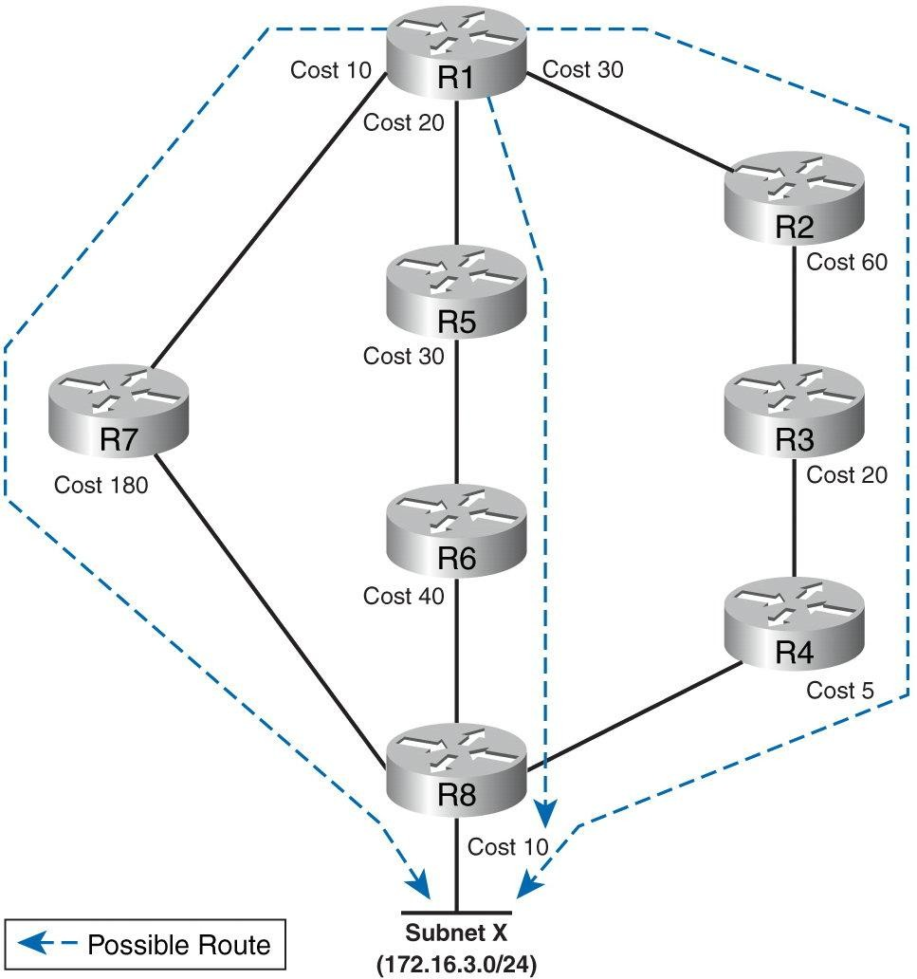
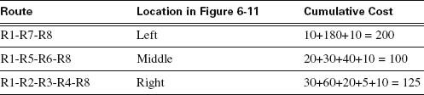
SPF Tree to Find R1’s Route to 172.16.3.0/24
Comparing R1‘s Three Alternatives for the Route to 172.16.3.0/24
As a result of the SPF algorithm‘s analysis of the LSDB, R1 adds a route to subnet 172.16.3.0/24 to its routing table, with the next-hop router of R5.

Slide 99
Reacting to Changes with Link-State Protocols
If the link between R5 and R6 (see previous slide) fails, R1 uses the following process determine a different route:(Similar steps would occur for changes to other routers and routes.)
R5 and R6 flood LSAs that state that their link is now in a down state. (In a network of this size, the flooding typically takes a second or two.)
All routers run the SPF algorithm again to see if any routes have changed. (This process may take another second in a network this size.)
All routers replace routes, as needed, based on the results of SPF.(This takes practically no additional time after SPF has completed.)
R1 changes its route for subnet X (172.16.3.0/24) to use R2 as the next-hop router.

Slide 100
Reacting to Changes with Link-State Protocols
These steps allow the link-state routing protocol to converge quickly – much more quickly than distance vector routing protocols.

Slide 101
Link-State Routing Protocols
Link-state concerns:
Processor overhead
Memory requirements
Bandwidth Consumption

Slide 102
Summarizing Features of the Link-State Routing Protocols
The main features of link-state routing protocols:
All routers learn the same detailed information about the states of all the router links in the internetwork.
The individual pieces of topology information are called LSAs, with all LSAs stored in RAM in the LSDB.
Routers flood LSAs when they are created, on a regular but long time interval if the LSAs do not change over time, and immediately when an LSA changes.
The LSDB does not contain routes, but it does contain information that can be processed by the Dijkstra SPF algorithm to find a router‘s best routes.

Slide 103
Summarizing Features of the Link-State Routing Protocols (Continued)
Each router runs the SPF algorithm, with the LSDB as input, resulting in the best (lowest cost/lowest-metric) routes being added to the IP routing table.
Link-state protocols converge quickly by immediately reflooding LSAs and rerunning the SPF algorithm.
Link-state protocols consume much more RAM and CPU than do distance vector routing protocols. If the internetwork changes a lot, link-state protocols can also consume much more bandwidth due to the (relative to distance vector protocols) large number of bytes of information in each LSA.

Slide 104
A Brief Review of IP Routing
A router determines the path of a packet from one data link to another, using two basic functions:
A path determination function
A switching function
The router uses the routing table to determine the best path and proceeds to forward the packet using the switching function.
The switching function is the internal process used by a router to accept a packet on one interface and forward it to a second interface on the same router.

Slide 105
Routing Protocol Features
Each routing protocol uses a metric to make choices about path determination:
RIP uses the concept of hop count, which is the number of routers between a router and some subnet.
OSPF uses the concept of link cost, with the SPF algorithm adding the cost of each link to determine the cost from a router, to a subnet, over each possible path.

Slide 106
Routing Protocol Features
EIGRP uses a metric that is based on link bandwidth and link delay, applying a mathematical function to both to come up with an integer value for a metric.
Cisco has developed a couple of proprietary IP routing protocols:
Interior Gateway Routing Protocol (IGRP), and its successor,
Enhanced Interior Gateway Routing Protocol (EIGRP).

Slide 107
Routing Protocol Features (Continued)
To run either routing protocol, you must use Cisco routers.
When IGRP was announced, it worked better than the only other alternative at the time (RIP).
Today, EIGRP works very well, competing with OSPF to be considered the best IGP IP routing protocol.
Some routing protocols, such as RIP, send periodic full routing updates. RIP sends updates every 30 seconds by default, regardless of whether anything has changed

Slide 108
Routing Protocol Features (Continued)
The updates include all routes known by that router, with some restrictions, which means the updates are "full".
Alternatively, other routing protocols (such as OSPF and EIGRP) send partial updates, which include only changes to routing information.
When a route fails, routing protocols typically still advertise the route, at least for a short time, but with a metric that implies the route has failed.

Slide 109
Routing Protocol Features (Continued)
Each routing protocol uses a special metric value, called an infinite metric, or simply infinity, to mean that a route has failed.
For example, RIP uses hop count as the metric. A metric of 15 hops is a valid usable metric, but a metric of 16 means “infinity,” and that the route has failed.

Slide 110
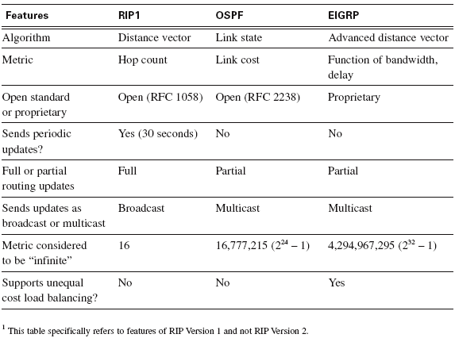
Comparing Features of IGPs: RIP, EIGRP, and OSPF

Slide 111
Summary
Routers perform many functions, with the two most important being to route (forward) packets and to learn routes.
To make routing work well, routers add routes to the IP routing table via three main methods:
Learning the routes for subnets connected to a router‘s interfaces
Configuring static routes
Using a dynamic routing protocol.

Slide 112
Summary
Static route operations can be divided into these three parts.
Network administrator uses the ip route command to configure a static route.
The router installs the route in the routing table.
The route is used to route packets.
Static routes may be beneficial in some cases like:
Dial backup connections;
Routers have only one connection to the rest of an internetwork;
Enterprise connection to internet, etc.

Slide 113
Summary
An AS is a collection of networks under the same administration that share a common routing strategy; for instance, the internetwork created by one company, one school, or one organization is likely to be a single AS.
The global Internet consists of most every AS in the world, with each AS having a registered (with IANA) unique AS number (ASN). Each AS connects to at least one ISP, and the world‘s ISPs have at least one path to reach all other ISPs.

Slide 114
Summary
Inside each AS, the engineers responsible for the AS can choose the AS‘s set of rules and policies, including choosing which Interior Gateway Protocol (IGP) to use. BGP is typically used between ASNs.

Slide 115
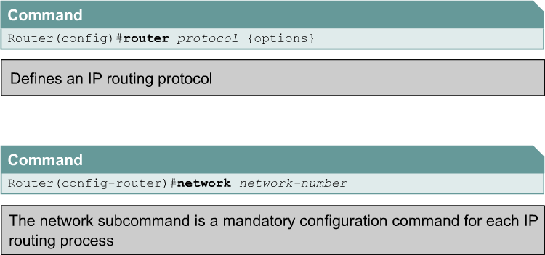
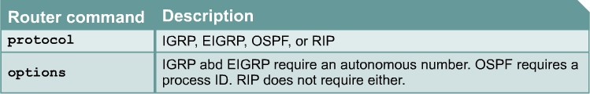
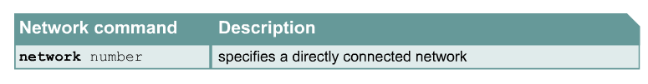
Configuring Dynamic Routing

Slide 116
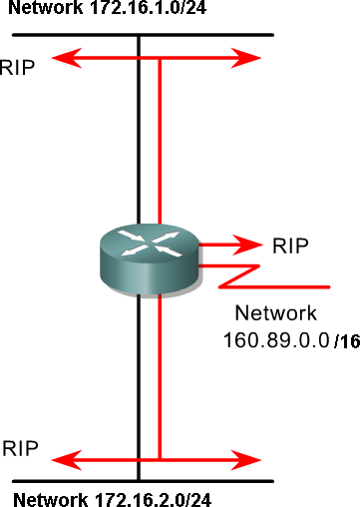
Routing Protocols
Router(config)#router rip
Router(config-router)#network 172.16.0.0
Router(config-router)#network 160.89.0.0
The network command is used on only directly connected networks.
With RIP and IGRP, only need to use the classful address (no subnets).

Slide 117
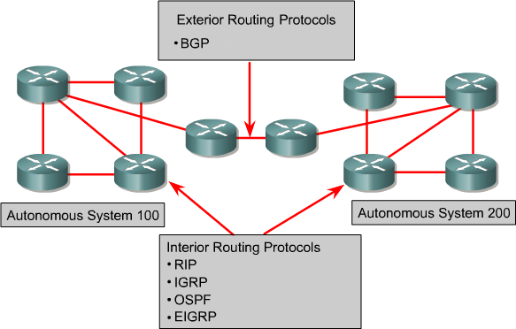
Routing Protocols
RIP – A distance vector interior routing protocol
IGRP – Cisco's distance vector interior routing protocol
OSPF – A link-state interior routing protocol
EIGRP – Cisco‘s advanced distance vector interior routing protocol
BGP – A distance vector exterior routing protocol

Slide 118
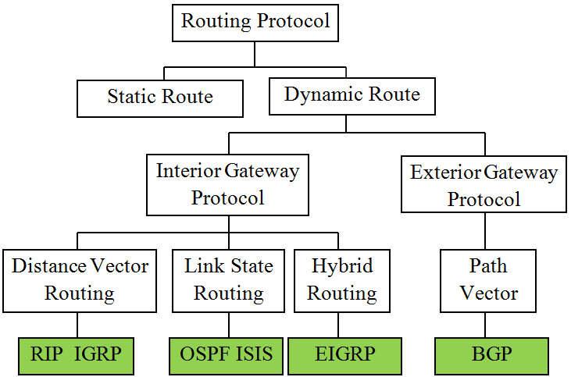
Routing Protocol

Slide 119
Routing Protocol
Routing Information Protocol (RIP)
Distance Vector Protocol
Use hops count as it‘s metric. If hop count exceeds 15, then the packet is discarded.
By default, updates are sent every 30 seconds.
Interior Gateway Routing Protocol (IGRP)
Distance Vector Protocol
Cisco Proprietary protocol.
Bandwidth, load, delay and reliability are used to create a
composite metric.
Routing updates are broadcast every 90 seconds, by default.

Slide 120
Routing Protocol
Open Shortest Path First (OSPF)
Link State Routing Protocol
Open standard routing protocol described in RFC 2328.
Uses the SPF algorithm to calculate the lowest cost to a destination.
Routing updates are flooded as topology changes occur.
Intermediate System to Intermediate System (IS-IS)
IS-IS is an Open System Interconnection (OSI) routing protocol originally specified by International Organization for Standardization (ISO) 10589.
It is a link-state routing protocol.

Slide 121
Routing Protocol
Enhanced Interior Gateway Routing Protocol (EIGRP)
Hybrid routing protocol: combination of distance vector and link- state features
Cisco proprietary protocol.
It is an enhanced distance vector routing protocol.
Uses unequal-cost and equal-cost load balancing.
Border Gateway Protocol (BGP)
An exterior routing protocol.
It is a distance vector (or path vector) exterior routing protocol
Used between ISPs or ISPs and clients.
Used to route Internet traffic between autonomous systems.

Slide 122
Which routing protocol?
Factors to consider in choosing a routing protocol
Bandwidth consumption
Timed updates will consume more bandwidth, although link-state initial flooding will consume bandwidth, later updates will consume minimal amounts.
Router processors capacity
Link state protocols require more of both than does distance vector protocols.
Router memory: Size of routing table

Slide 123
Which routing protocol?
Factors to consider in choosing a routing protocol
Convergence time
Time require to all routers within an internetwork are operating with the same knowledge
Some protocol has faster convergence time while other has problem
such as routing loops

Slide 124

124
Notes:
124

Slide 125
NEXT LECTURE ROUTING LOOPS
Notes:
125

